Slide 1
Trusted Digital Web - Hyperonomy Business Blockchain - NEO-NATION
2019-03-23

Slide 2
Hyperonomy Business Blockchain Decentralized Identifier URL Specification (did-url-spec) https://github.com/mwherman2000/did-url-spec
Michael Herman
Independent Blockchain Architect
mwherman@parallelspace.net

Slide 3
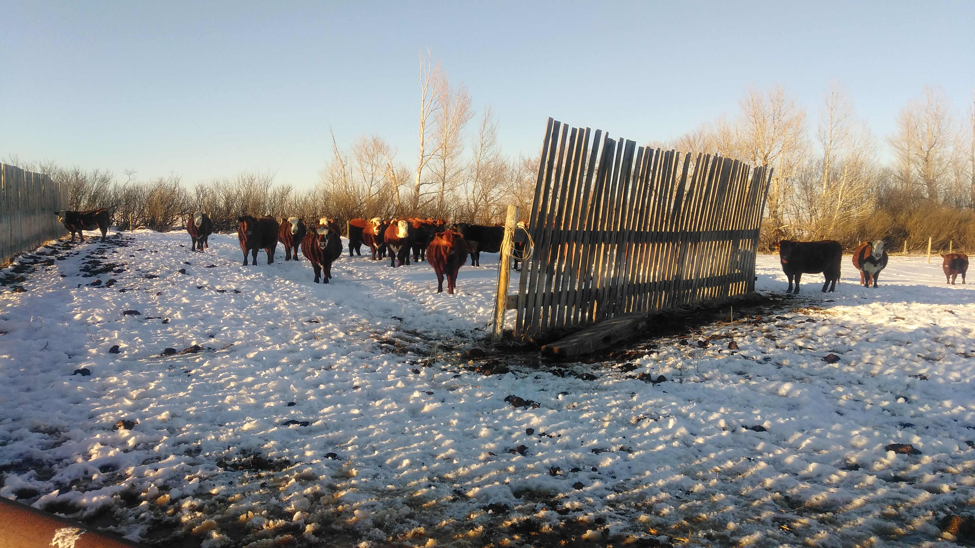
Michael Herman Independent Blockchain Architect Alberta, CANADA

Slide 4
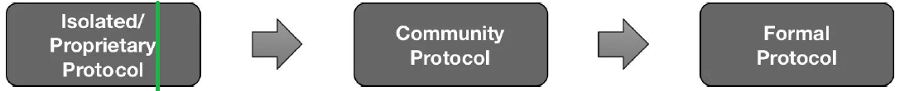
Status
The status of this specification is that it is a work-in-progress community member contribution.
The current intention is for this specification to be merged into the W3C Decentralized Identifiers specification directly, by reference, or as an appendix.

Slide 5
Purpose and Goals
Purpose
The purpose of this specification is to document the development of as well as the final version of the did-url grammar for the Decentralized Identifier URL Specification (did-url-spec).
Audience
The primary audience for this specification is implementors and maintainers of parser software that is compliant with the did-url-spec including but not limited to:
W3C Decentralized Identifier specification
DID Resolvers and DID Resolution
Agent-to-Agent (A2) Communications services in the Hyperledger Indy Agent framework
Goals
document the development of the did-url-spec version of the did-url grammar
publish the final version of the grammar

Slide 6
Decentralized Identifier URL Specification (did-url-spec) User Scenarios / Applications
W3C Decentralized Identifier specification
DID Resolvers and DID Resolution
Agent-to-Agent (A2) Communications services in the Hyperledger Indy Agent framework
Attachments
Feature discovery
Others?
NOTE
This document is specification specifically for Decentralized Identifier URLs ...described by the did-url grammar using the ABNF notation.
For a better understanding of this terminology, read Giving Grammars Written with ABNF Notation the Respect They Deserve (https://hyperonomy.com/2019/03/11/giving-grammars-written-with-abnf-notation-the-respect-they-deserve/.

Slide 7
Decentralized Identifier URL Specification (did-url-spec) Input/output Scenarios
Id | Inputs | Outputs
a. | <did> | DID Document
b. | <did>#xyz –or– did!$selectId=“xyz” | DID Document Fragment
c. | <did>!$serviceId=“bops” | Service Endpoint URI/URL
d. | <did>!$selectId=“bops” | DID Document Service Endpoint Fragment
e. | <did>!$serviceId="bops"/foo/bar?a=1#flip | Service Endpoint URI/URL w/parameters
f. | "query": “<did>!$filter=‘spec/tictactoe/1.’“ "query": “<did>!$filter=‘*’” | Array of Indy Agent features (e.g. message families)

Slide 8
DRIVERS
During the Feb. 21, 2019 DID Resolution community call, there was a early/initial discussion about using an HTTP binding pattern such as:
http://uniresolver.io/resolve/did:xyz:1234
http://uniresolver.io/dereference/did:xyz:1234#key1
It was surprising to see the above pattern being proposed because the resolve and dereference operations are redundant.
I assume that the purpose of the current "DID ABNF" syntax discussions is to encapsulate these types of operations into a did-url grammar. Based on this assumption, the following did-url patterns (and HTTP bindings) are being recommended for use as the primary patterns for the previous 2 use cases:
Resolution: http://uniresolver.io/did:xyz:1234
Dereferencing (general case): http://uniresolver.io/did:xyz:1234#key1 and, optionally, http://uniresolver.io/did:xyz:1234!$selectId="key1"

Slide 9
Approach
The general approach is:
Use the original architectural principles from the draft `did-spec` as well as the higher-level DID use cases from several documents (see below) to create a comprehensive list of lower-level did-url use cases for the did-url grammar.
Use the lower-level did-url use cases which in turn can drive the design of the did-url grammar (expressed at a higher level using ABNF notation).
Use the did-url grammar design to drive the implementation (i.e. ABNF source code) for the actual did-url grammar.
Validate the did-url grammar by testing using test cases based on the did-url lower-level use cases.
Iterate.

Slide 10
Guiding Principles (1/2)
Follow the Core Principles expressed in the following documents:
The #OpenToInnovation Principle: Internet protocols and standards not only need to be open, but more importantly, open to innovation (https://hyperonomy.com/2019/03/12/internet-protocols-and-standards-not-only-need-to-be-open-but-more-importantly-open-to-innovation/)
Giving Grammars Written with ABNF Notation the Respect They Deserve (https://hyperonomy.com/2019/03/11/giving-grammars-written-with-abnf-notation-the-respect-they-deserve/)
Ensure that an app developer has the tools he/she needs to be able to effectively search, find, resolve, and dereference:
a single DID Document associated with a DID, or
a collection of DID Documents based on several criteria (defined in the use cases)
Ensure that an app developer has the tools he/she needs to be able to effectively search, find, resolve, dereference, and execute:
a service endpoint associated with a service-id in a single DID Document associated with a DID.

Slide 11
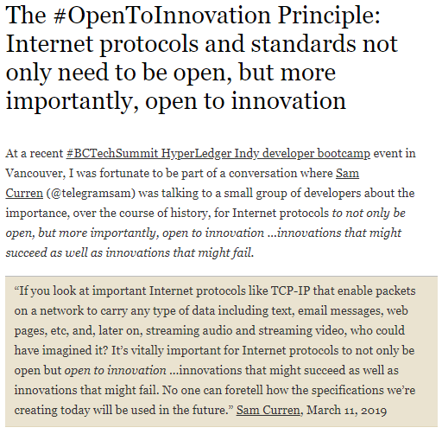
#1.1

Slide 12
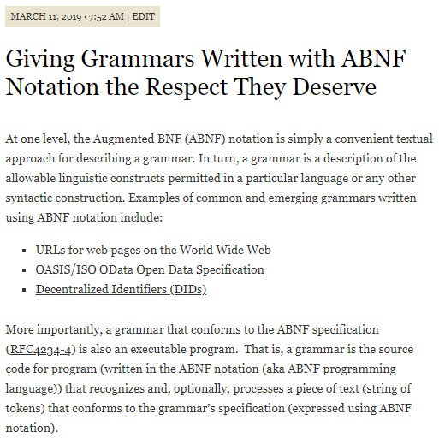
#1.2 (1/3)

Slide 13
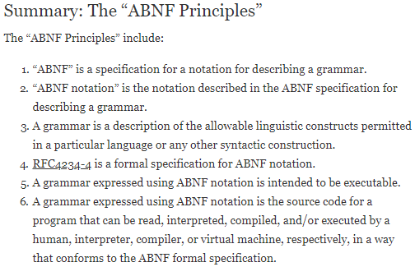
#1.2 (2/3)

Slide 14
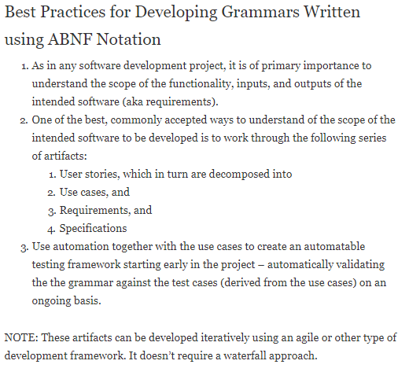
#1.2 (3/3)

Slide 15
Guiding Principles (2/2)
Ensure that the above operations and capabilities are expressed in a consistent did-url syntax - eliminating the need for creating additional language and/or API constructs, where possible.
Ensure that the draft "DID ABNF" supports the above goals and doesn't unnecessarily restrict future innovation with respect to did-url parsing (and DID Resolution, specifically but not exclusively) ...that is, that the "DID ABNF" doesn't restrict the syntax patterns needed for present and future did-url parsing (and DID Resolution, specifically but not exclusively) innovation. This is especially important because the current "DID ABNF" is completely defined in a different specification from the DID Resolution specification (i.e. the DID Specification).
Ensure that an app developer has the tools he/she has the basic operational capabilities available to test if a DID Resolver is alive and responsive, control the format of the DID Resolver response, etc.
The did-url use cases (the lower-level did-url use cases) will be guided/driven by the specific higher-level use case documents listed below. See Principle 1.2 above.

Slide 16
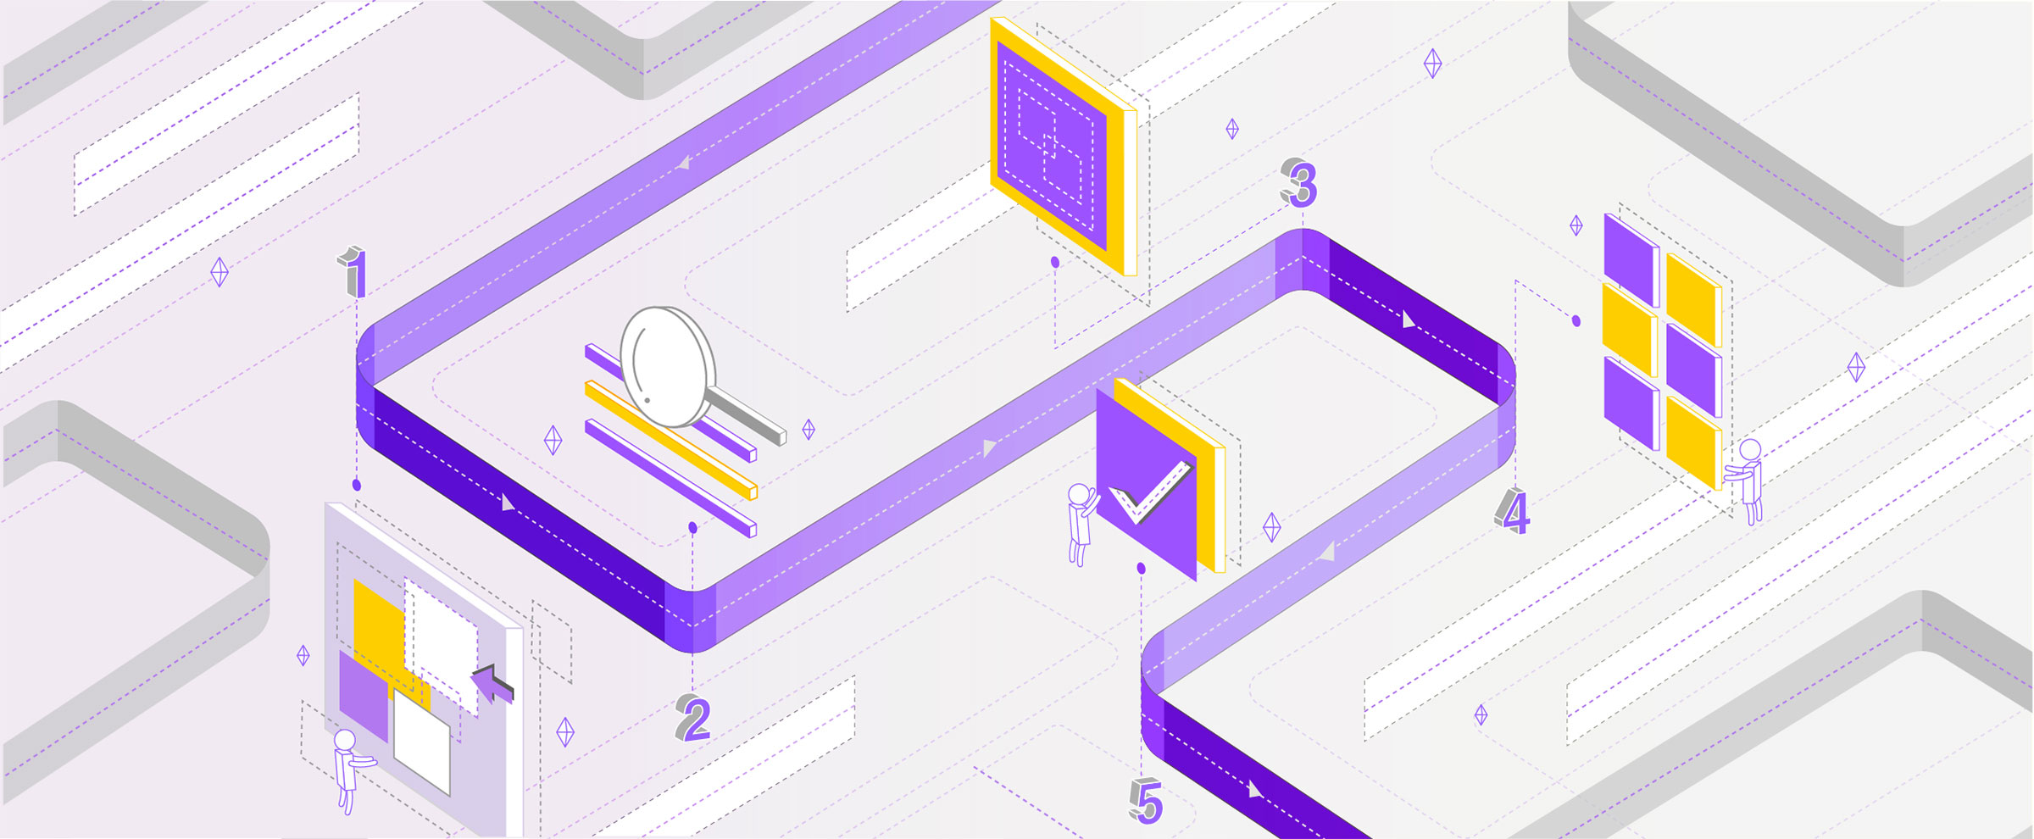
 Background
Michael Herman
Independent Blockchain Architect
mwherman@parallelspace.net
Trusted Digital Web - Hyperonomy Business Blockchain - NEO-NATION
2019-03-23

Slide 17
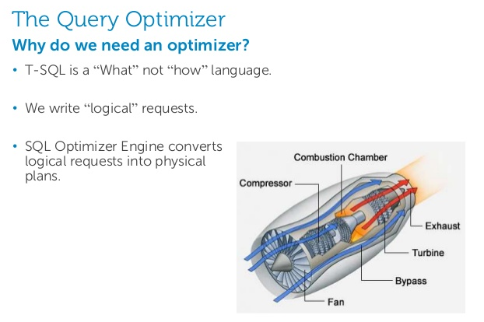
Generic Parsing and Processing (1/3)
Declarative language – not a Functional language

Slide 18
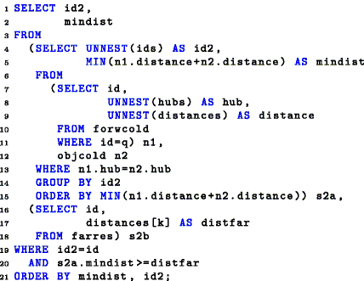
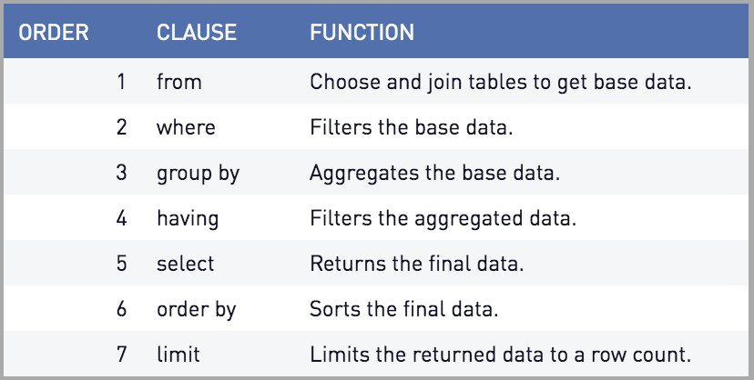
Generic Parsing and Processing: SQL Example
T-SQL is a Declarative language – it describes what is to be returned
T-SQL is not a Functional language – it doesn’t describe how to access or how to enumerate over the data store
Clause Ordering is Declarative – not Functional

Slide 19
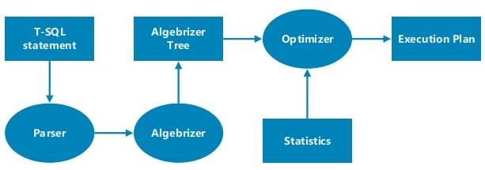
Generic Parsing and Processing
Parsing
Processing
T-SQL
Statement
7
did-url
1
Cypher
Statement
4
5
Hard Parse
2
3
6
Soft Parse

Slide 20
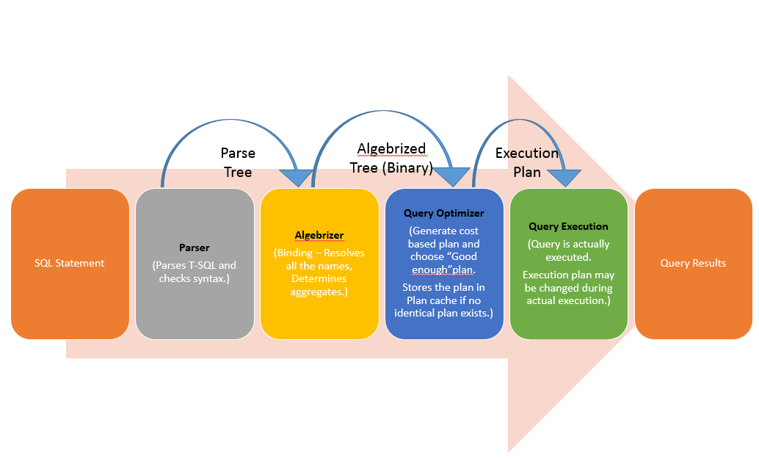
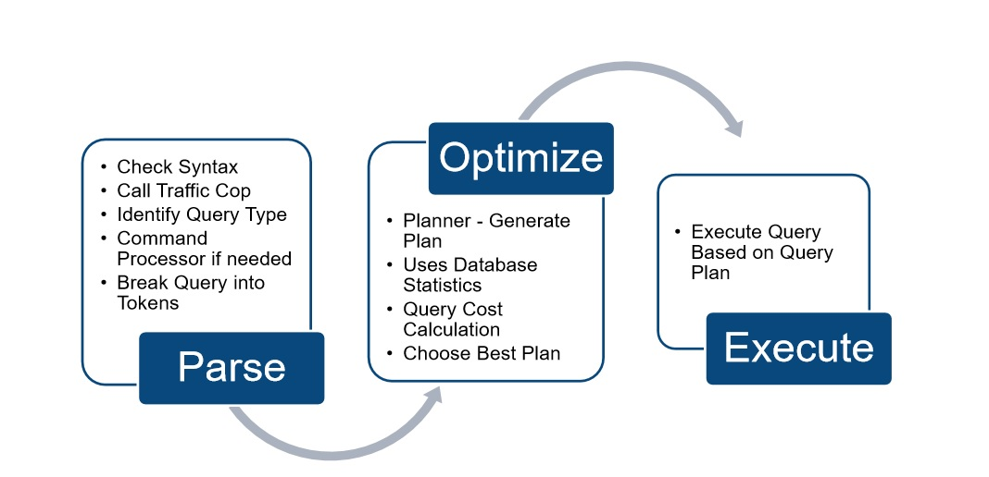
SQL Server Query Execution Flow (T-SQL Query)

Slide 21
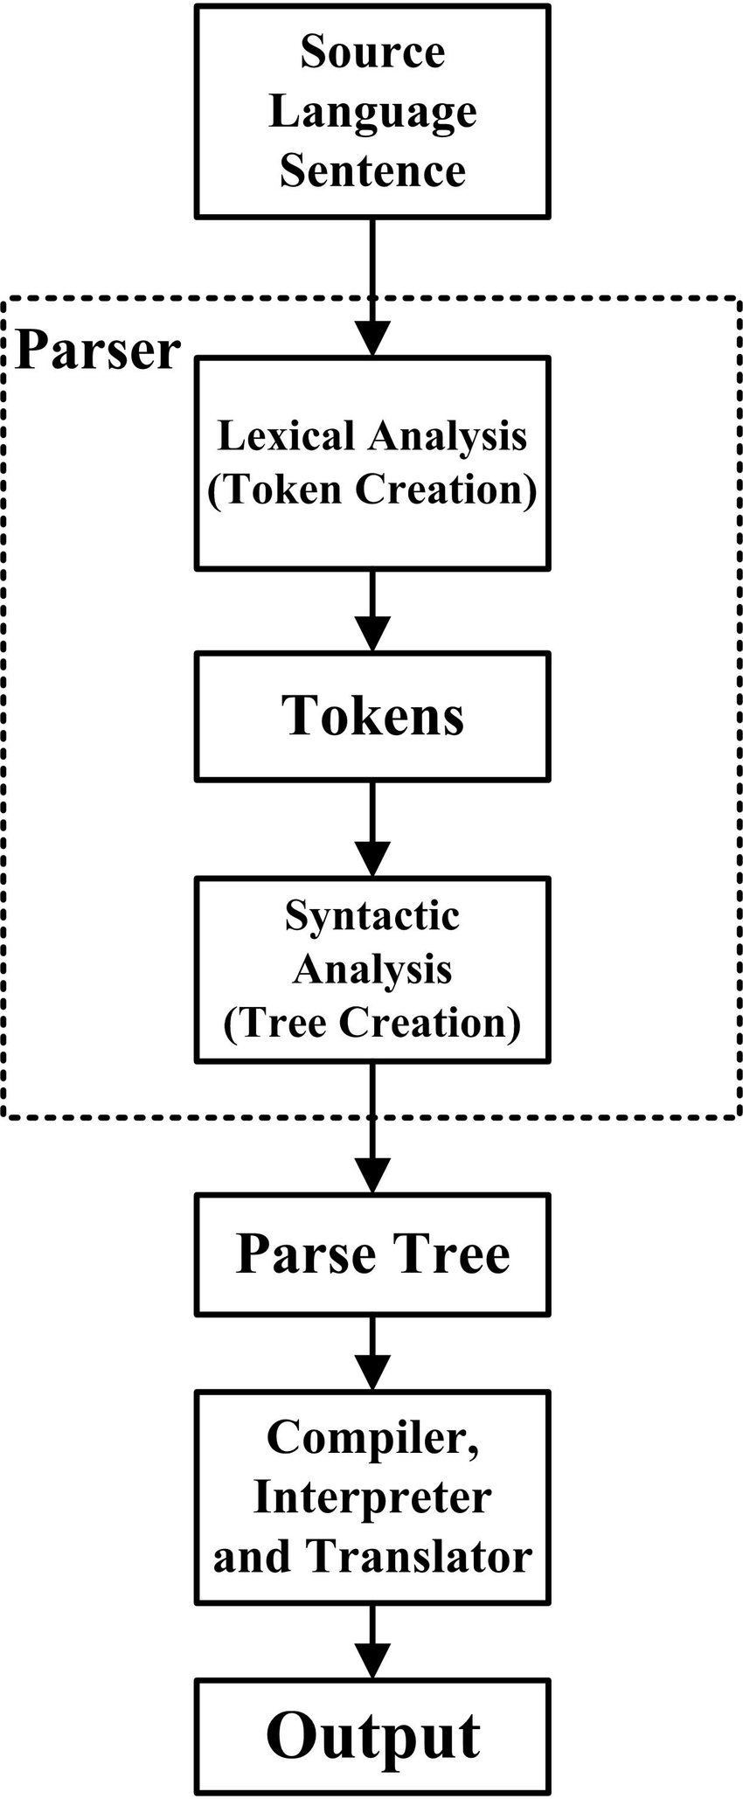
Soft Parse vs. Hard Parse
A Soft Parse is when a did-url is comprised of a did only (with no additional grammar rules (features) specified)
Only physical access optimizations are possible
A Hard Parse is when a did-url is comprised of a did plus additional grammar rules (features)
Additional types of optimizations are possible (e.g. $exist)
Soft
Parse
Hard Parse

Slide 22
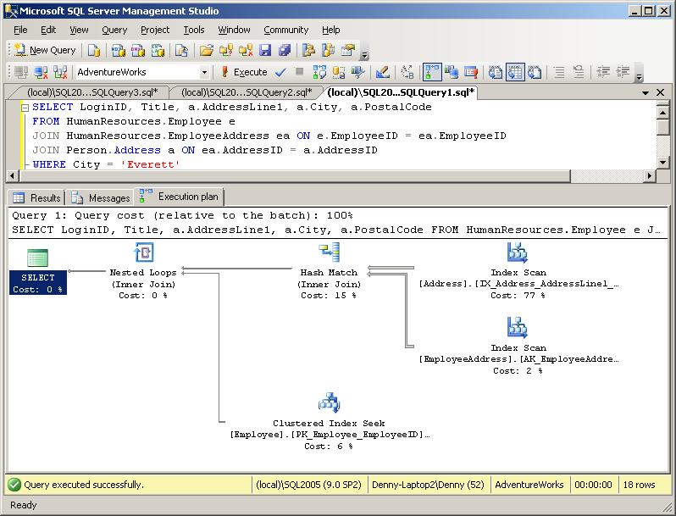
Processing: Execution Plans (T-SQL)

Slide 23
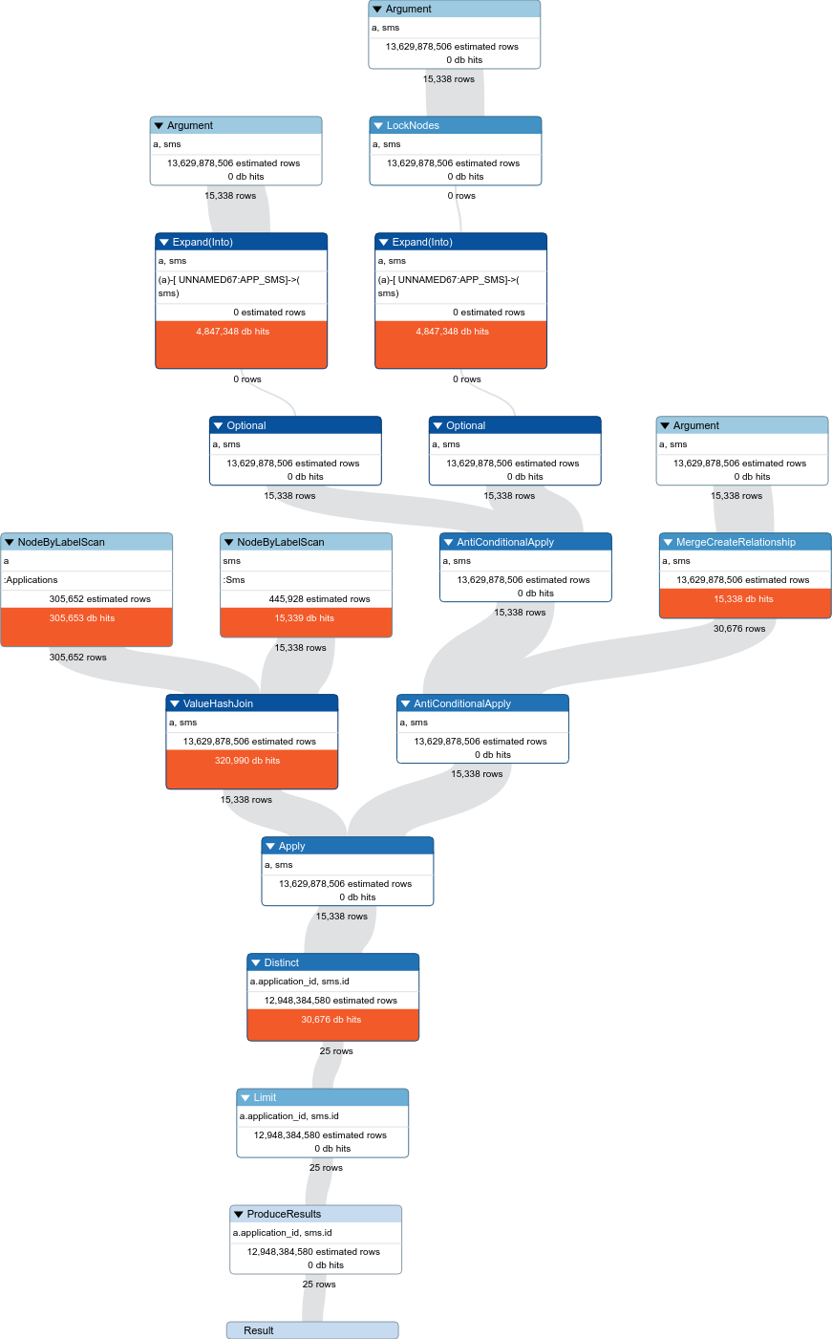
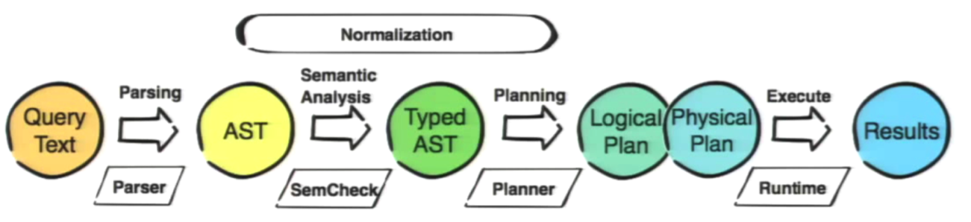
Processing: Execution Plans (Cypher/Neo4J) Neo4j Graph Database
MATCH (a:Applications), (sms:Sms {id: a.application_id})
MERGE (a)-[r:APP_SMS]->(sms)
RETURN distinct a.application_id, sms.id
I have only found a possibility to use distinct in a return part of the query.
I have executed the same query with profile and limit 25 to see the query plan and results:
10382692 total db hits in 3219 ms
Credit: https://stackoverflow.com/questions/52465038/merge-query-optimization-neo4j?rq=1

Slide 24
 did-url Parsing and Processing
Michael Herman
Independent Blockchain Architect
mwherman@parallelspace.net
Trusted Digital Web - Hyperonomy Business Blockchain - NEO-NATION
2019-03-23

Slide 25
Quick Review: Parsing and Processing
TODO

Slide 26
DID Resolution vs. DID Dereferencing
TODO

Slide 27
DID Document Examples
DID Spec - Example 16
INDY-ARM Example
Windley Article Example

Slide 28
 An Example
Michael Herman
Independent Blockchain Architect
mwherman@parallelspace.net
Trusted Digital Web - Hyperonomy Business Blockchain - NEO-NATION
2019-03-23

Slide 29
did-url Service Endpoint Transformers: Use Cases
H. DID URL Service Endpoint Transformation Use Cases (using "!" transformer (pipe) option and $serviceId transform option)
These following use cases use the "!" transformer (pipe) option and $serviceId transformer (pipe) option (aka $serviceId transformer). These tokens immediately follow is formally the text that matches be the did rule. The semantics are: take the did text (up to the "!" pipe option) and pass it through a transformation represented by the transform options that follow the "!" transformer (pipe) option.
For example, if the transformer is $serviceId="<service-id>", the effect would be to produce the resolved URL/URI for, in this case, the service endpoint corresponding service-id. See the table below for more specific examples of the syntax.
Conceptually, the processing is: did-url | transform(tranformOptions) to produce a transformed-url

Slide 30
did-url Service Endpoint Transformers: Examples
Here's are 2 specific examples based on the Windley examples. These examples also make clear the difference between the transformer approach and the ';' approach. The subject DID document is from Windley article.
Approach Example
Windley did:sov:123456789abcdefghij;exam_svc
Transformer did:sov:123456789abcdefghij!$serviceId="exam_svc"
Both of the above did-url’s resolve (dereference) to the same URI/URL: https://example.com/endpoint/8377464
Approach Example
Windley did:sov:123456789abcdefghij;exam_svc/foo/bar?a=1#flip
Transformer did:sov:123456789abcdefghij!$serviceId="exam_svc"/foo/bar?a=1#flip
Both of the above did-url’s resolve (dereference) to the same URI/URL: https://example.com/endpoint/8377464/foo/bar?a=1#flip

Slide 31
did-url Service Endpoint Transformers: NOTES
NOTE: DID schemes and/or DID Resolvers can define additional transform options. They are not limited by the syntax specification.
NOTE: The ";" token is no longer used anywhere in DID syntax patterns represented across all of the use case categories.
NOTE: Related (and reflecting the views of @dhh128 in comment https://github.com/w3c-ccg/did-spec/pull/168#issuecomment-471655338), there should no longer be a need to use ";' or any special symbol (other than "#") in the id attribute of a service endpoint in a DID Document.

Slide 32
 Lower-Level did-url Use Cases
Michael Herman
Independent Blockchain Architect
mwherman@parallelspace.net
Trusted Digital Web - Hyperonomy Business Blockchain - NEO-NATION
2019-03-23

Slide 34
Lower-Level did-url Use Cases: B (superceded by H)

Slide 35
Lower-Level did-url Use Cases: C

Slide 37
Lower-Level did-url Use Cases: E

Slide 38
Lower-Level did-url Use Cases: F

Slide 39
Lower-Level did-url Use Cases: G

Slide 40
Lower-Level did-url Use Cases: H

Slide 41
Lower-Level did-url Use Cases: I

Slide 42
Lower-Level did-url Use Cases: J

Slide 43
Lower-Level did-url Use Cases: J

Slide 44
 Grammar Testing / Validation
Michael Herman
Independent Blockchain Architect
mwherman@parallelspace.net
Trusted Digital Web - Hyperonomy Business Blockchain - NEO-NATION
2019-03-23

Slide 45
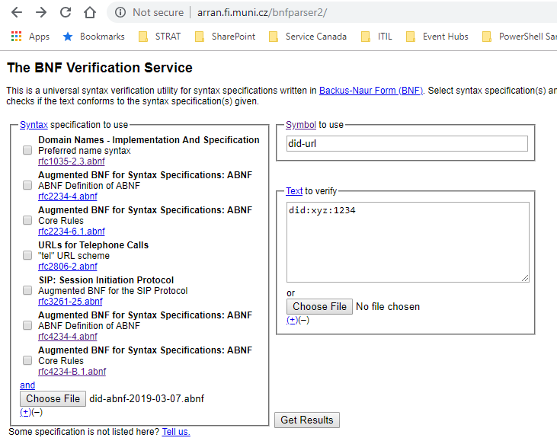
Grammar Testing / Validation
did-url Grammar Validation Tool (Web)
The following web app is being used to validate the did-url grammar against the lower-level use cases: The BNF Verification Service (http://arran.fi.muni.cz/bnfparser2/)

Slide 46
Impacts
Impact on DID Document Grammar
";" is no longer needed/used in a DID Document
From a syntactical perspective, all "anchors" / "selection IDs" are prefixed with a '#' only.
The semantic meaning is determined by the referring did-url transformer.
Impact on Other Specifications
Hyperledger Indy HIPEs
Feature discovery “filter” operator
Attachments id attributes
Others?

Slide 47
 Wrapping UP…
Michael Herman
Independent Blockchain Architect
mwherman@parallelspace.net
Trusted Digital Web - Hyperonomy Business Blockchain - NEO-NATION
2019-03-23

Slide 48
 QUESTIONS?
Michael Herman
Independent Blockchain Architect
mwherman@parallelspace.net
Trusted Digital Web - Hyperonomy Business Blockchain - NEO-NATION
2019-03-23

Slide 49
Trusted Digital Web - Hyperonomy Business Blockchain - NEO-NATION
2019-03-23

